Slide 1
Presented by -
JOY PAL
Stu_ID : 201002418
Dept. of CSE
Green University of Bangladesh
Web Programming – CSE 301

Slide 2
SESSION in PHP

Slide 3
TABLE OF CONTENTS
01
02
03
PHP
Session
Session Fundamental
Short Review
Why, where session is used?
How its work?
Start a session
Ending a session Session timeout etc.
3

Slide 4

PHP Hypertext Preprocessor
server-side scripting language
a powerful tool for making dynamic and interactive Web pages.
PHP is a widely-used, free, and efficient alternative to competitors such as Microsoft's ASP.
4

Slide 5
Session in PHP
Generally session means limited period of time or a period devoted to a particular activity.
There is no continuous connection between client and server.
Allow to track information of user.
A browser request a page from server – connection opens between both, server get the request and sends back the response – connection closed
5

Slide 6
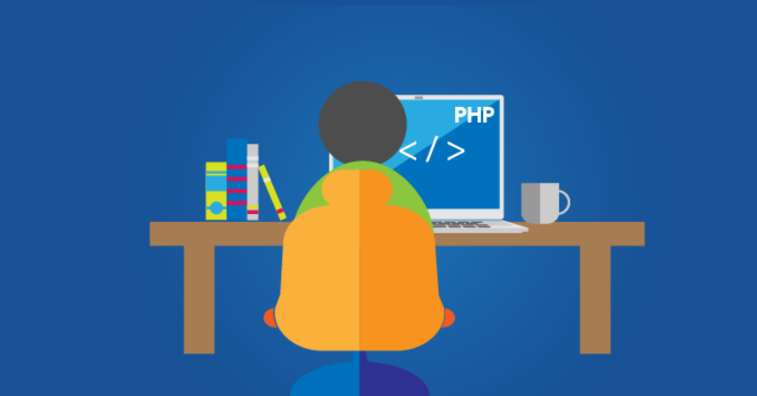
Why & Where Session is Used ?
Stored the information is a hidden form field, then it persist only if the form is submitted.
To make data accessible across the various pages of an entire website.
Suppose a user is buying book online, there should be a mechanism to keep track of books added by user to basket.
6

Slide 7
How Session Works
Session is a file stored on server.
Client’s browser makes an initial request to the server.
The browser sends a request to the server. PHP responds by sending a unique token that identifies the current session.
server notes client's IP address/browser, stores some local session data, and sends a session ID back to client (as a cookie)
server uses session ID cookie to retrieve its data for the client's session later
7

Slide 8
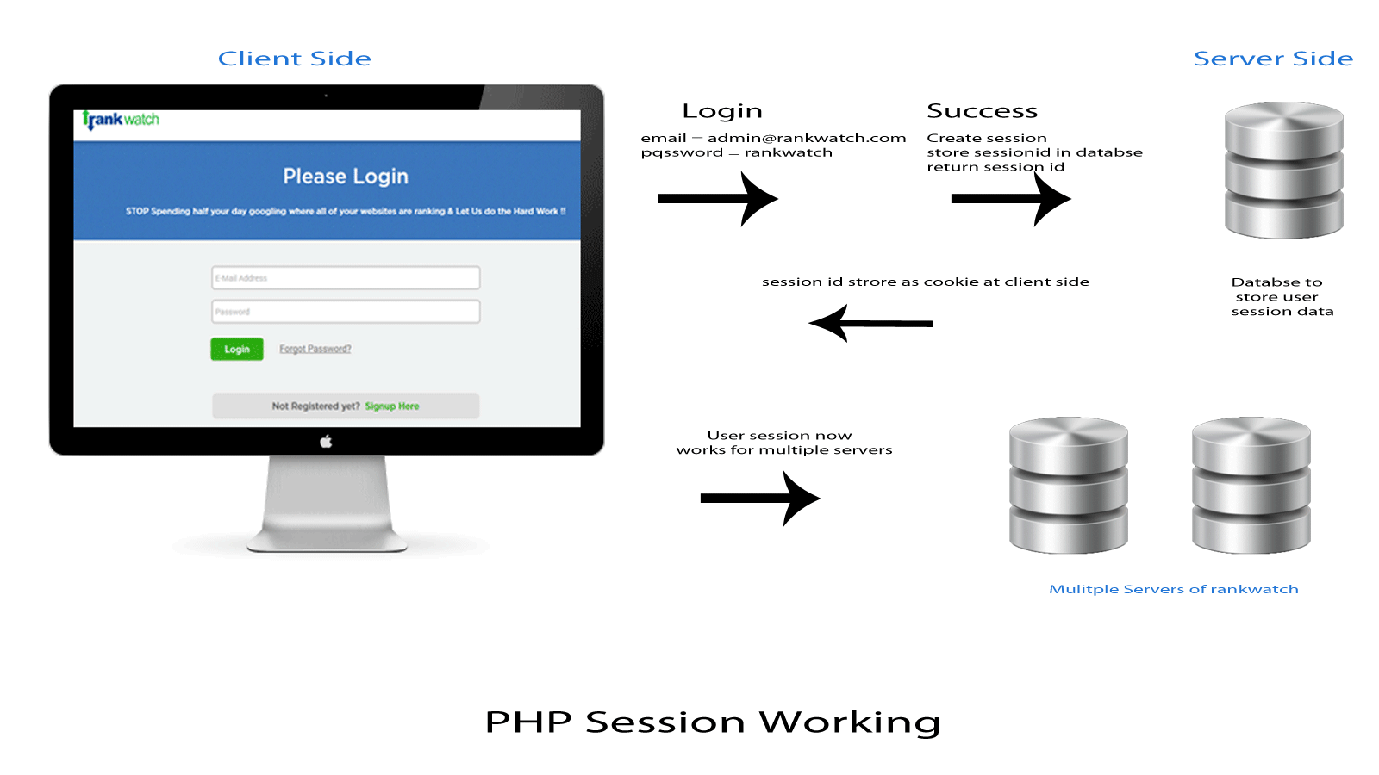
PHP Session Working (example)
8

Slide 9
Start a PHP Session
A Session is started with the session_start( ) function.
call session_start ( ) :
if the server hasn't seen this user before, a new session is created
otherwise, existing session data is loaded into $_SESSION associative array
you can store data in $_SESSION and retrieve it on future pages
9

Slide 10
Start a PHP Session (example)
<?php session_start(); // Start the session ?> <!DOCTYPE html> <html> <body> <?php // Set session variables $_SESSION["favcolor"] = "green"; $_SESSION["favanimal"] = "cat"; echo "Session variables are set."; ?> </body> </html>
The session_start() function must be the very first thing in your document. Before any HTML tags.
10

Slide 11
Accessing session data
$_SESSION["name"] = value; # store session data
$variable = $_SESSION["name"]; # read session data
if (isset($_SESSION["name"])) { # check for session data
if (isset($_SESSION["points"])) {
$points = $_SESSION["points"];
print("You've earned $points points.\n");
} else {
$_SESSION["points"] = 0; # default
11

Slide 12
Ending a session
To remove all global session variables and destroy the session, use session_unset() and session_destroy()
session_destroy ends your current session
if you may want to start a completely new empty session later, it is best to flush out the old one
session_destroy();
session_regenerate_id(TRUE); # flushes out session #ID number
session_start();
12

Slide 13
Ending a session (example)
<?php session_start(); ?> <!DOCTYPE html> <html> <body> <?php session_unset(); // remove all session variables session_destroy(); // destroy the session ?> </body> </html>
13

Slide 14
Session Timeout
Because HTTP is stateless, it is hard for the server to know when a user has finished a session
ideally, user explicitly logs out, but many users don't
server automatically cleans up old sessions after a period of time
old session data consumes resources and may present a security risk
adjustable in PHP server settings or with session_cache_expire function
you can explicitly delete a session by calling session_destroy
14

Slide 15
THANKS !

